Slide 1
React + A.I.
Building React components with using LLM

Slide 2
React 101
https://github.com/marcus-yeagle/react-tutorial
https://react.dev/learn/tutorial-tic-tac-toe (source)

Slide 3
React 101
Setup - will give you a starting point to follow the tutorial.
Overview will teach you the fundamentals of React: components, props, and state.
Completing the game - will teach you the most common techniques in React development.
Adding Time Travel - will give you a deeper insight into the unique strengths of React.
Finally - Make A.I. do all the work

Slide 4
React 101
Setup
Ensure you have installed and setup a proper JS runtime environment with node and npm
Copy the Github source code onto your machine:
https://github.com/marcus-yeagle/react-tutorial

Slide 5
Demo

Slide 6

React 101 - Components
The code in App.js creates a component. In React, a component is a piece of reusable code that represents a part of a user interface. Components are used to render, manage, and update the UI elements in your application. Let’s look at the component line by line to see what’s going on:
export default function Square() {
return <button className="square">X</button>;
}

Slide 7
React 101 - Components
The code in App.js creates a component. In React, a component is a piece of reusable code that represents a part of a user interface. Components are used to render, manage, and update the UI elements in your application. Let’s look at the component line by line to see what’s going on:
export default function Square() {
return <button className="square">X</button>;
}

Slide 8

React 101 - Components
export default function Square() {
return (
<>
<button className="square">X</button>
<button className="square">X</button>
</>
);
}

Slide 9
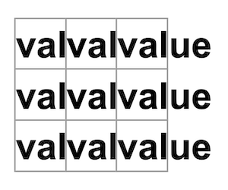
React 101 - Components
function Square({ value }) {
return <button className="square">value</button>;
}

Slide 10
React 101 - Components
function Square({ value }) {
return <button className="square">{value}</button>;
}

Slide 11
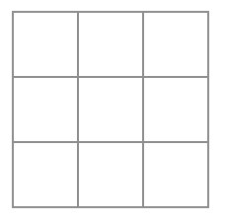
React 101 - Components
function Square({ value }) {
return <button className="square">{value}</button>;
}

Slide 12
React 101 - Components
import { useState } from 'react';
function Square() {
const [value, setValue] = useState(null);
function handleClick() {
setValue('X');
}
return (
<button
className="square"
onClick={handleClick}
>
{value}
</button>
);
}
export default function Board() {
return (
<>
<div className="board-row">
<Square />
<Square />
<Square />
</div>
<div className="board-row">
<Square />
<Square />
<Square />
</div>
<div className="board-row">
<Square />
<Square />
<Square />
</div>
</>
);
}

Slide 13
React 101 - Components
import { useState } from 'react';
function Square() {
const [value, setValue] = useState(null);
function handleClick() {
setValue('X');
}
return (
<button
className="square"
onClick={handleClick}
>
{value}
</button>
);
}
export default function Board() {
return (
<>
<div className="board-row">
<Square />
<Square />
<Square />
</div>
<div className="board-row">
<Square />
<Square />
<Square />
</div>
<div className="board-row">
<Square />
<Square />
<Square />
</div>
</>
);
}
['O', null, 'X', 'X', 'X', 'O', 'O', null, null]

Slide 14
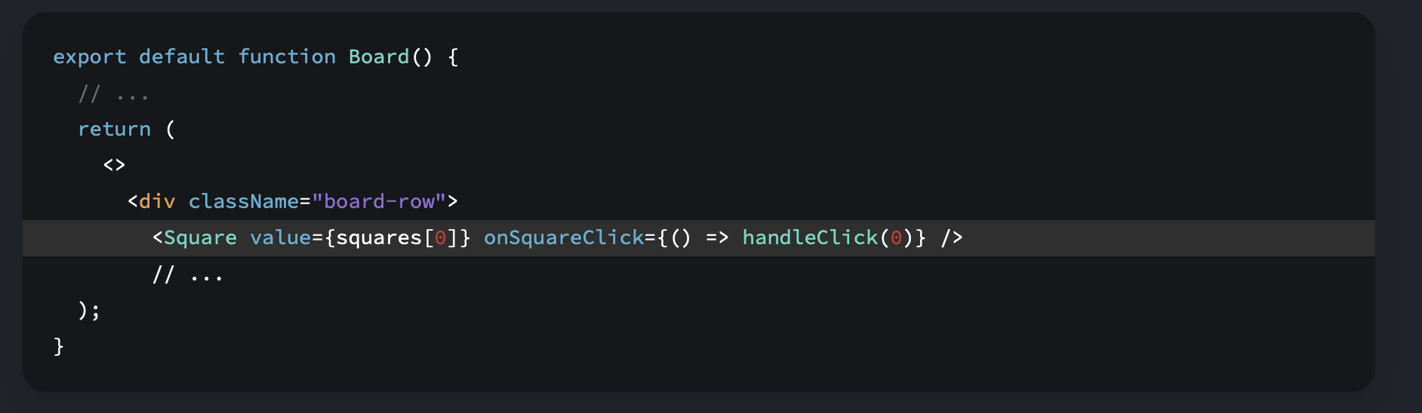
React 101 - Components

Slide 15
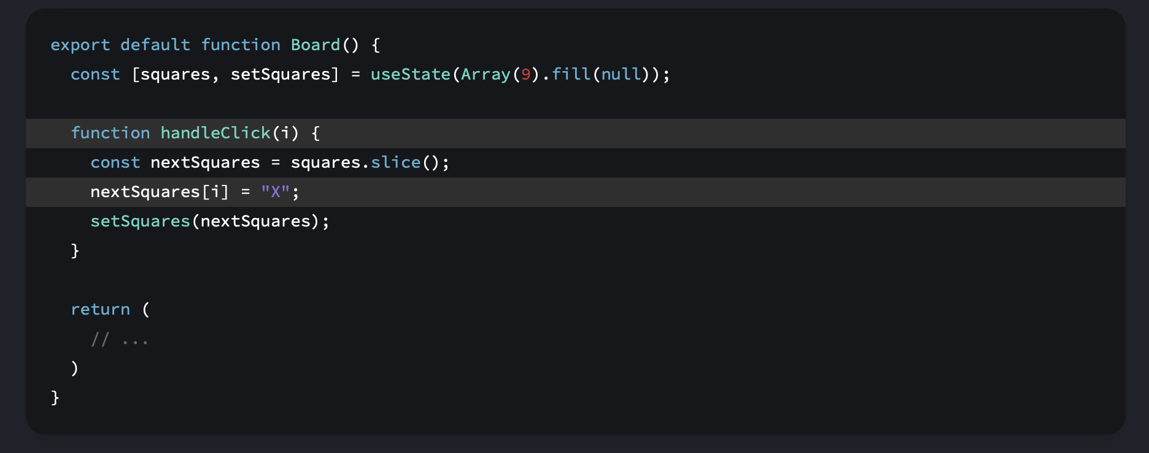
React 101 – Component State
The handleClick function creates a copy of the squares array (nextSquares) with the JavaScript slice() Array method. Then, handleClick updates the nextSquares array to add X to the first ([0] index) square.
Calling the setSquares function lets React know the state of the component has changed. This will trigger a re-render of the components that use the squares state (Board) as well as its child components (the Square components that make up the board).

Slide 16
React 101 – Component State
The handleClick function creates a copy of the squares array (nextSquares) with the JavaScript slice() Array method. Then, handleClick updates the nextSquares array to add X to the first ([0] index) square.
Calling the setSquares function lets React know the state of the component has changed. This will trigger a re-render of the components that use the squares state (Board) as well as its child components (the Square components that make up the board).

Slide 17
React 101 – Component State
- Now that your state handling is in the Board component, the parent Board component passes props to the child Square components so that they can be displayed correctly.
- When clicking on a Square, the child Square component now asks the parent Board component to update the state of the board.
- When the Board’s state changes, both the Board component and every child Square re-renders automatically.
- Keeping the state of all squares in the Board component will allow it to determine the winner in the future.

Slide 18
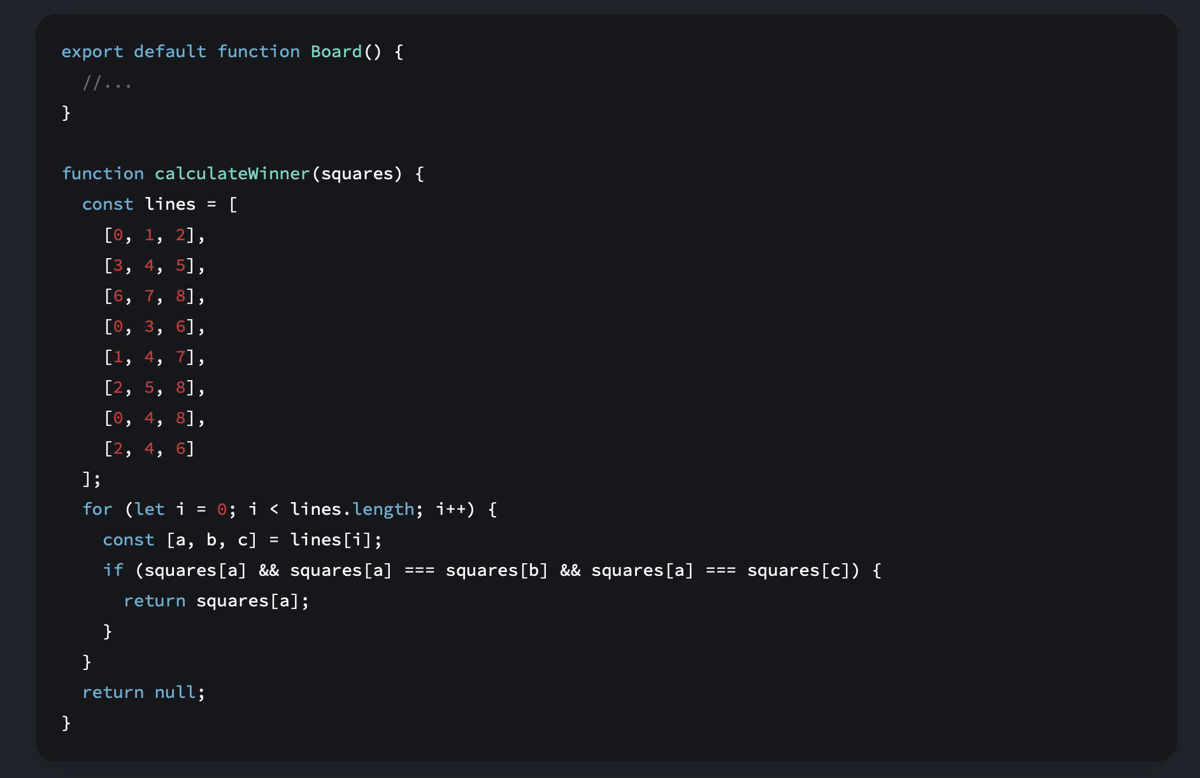
React 101 – Component State

Slide 19
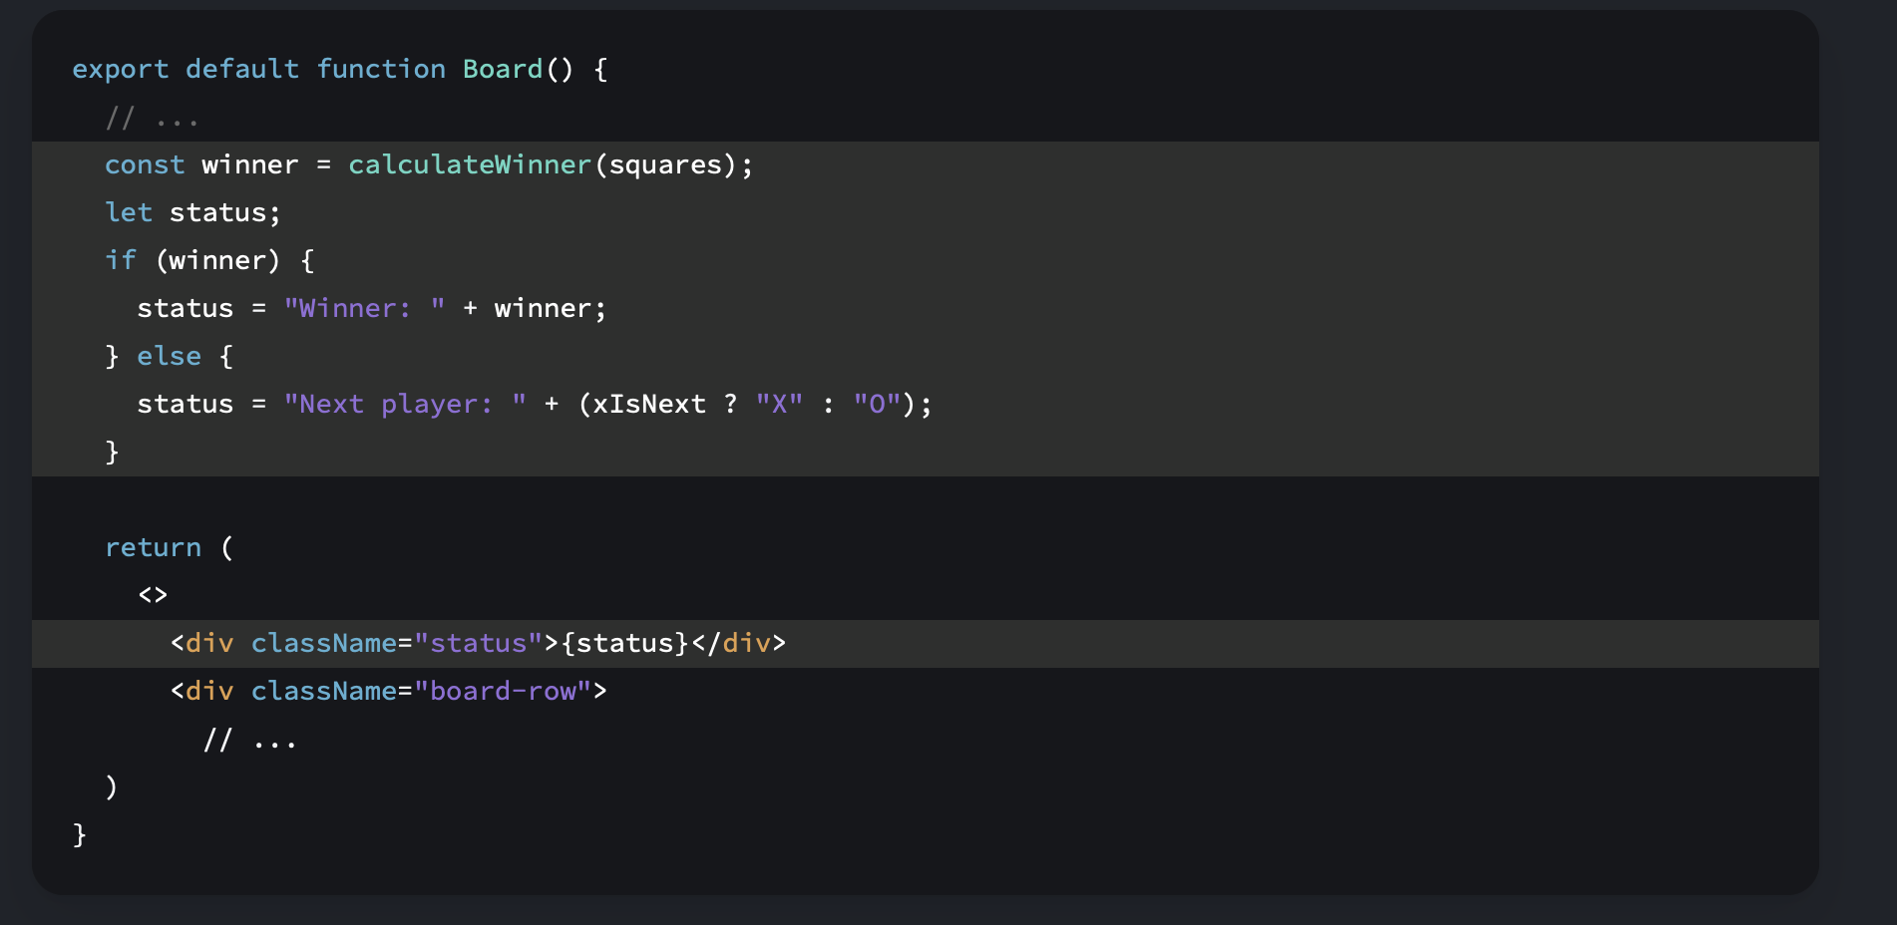
React 101 – Component State

